Slide 1

SY26-27 Budget Proposal
PREPARED MAY 2026 BY
EdOps

Slide 2
Executive Summary
Budget Process
● PCSB requires a 2-year budget, so the budget presented here represents our assumptions for both FY27 and FY28. As we do every year, we will re-budget FY28 in the first half of 2027; you are voting on the FY27 budget while the FY28 budget is just a preview of our initial assumptions.
● The school’s fiscal year (FY) runs July 1 – June 30, meaning the budgets cover
7/1/2026 – 6/30/2027 and 7/1/2027-
6/30/2028.
● We developed this budget using
historical expense information, the most recent communications from the D.C. Mayor’s office regarding revenue expectations, as well as our own targets for enrollment, staffing, and program.
● Detailed assumptions are outlined on
subsequent pages.
Budget Overview & Strategic Priorities
The FY27 budget has a positive operating margin – net income before depreciation and amortization (EBIDA) – though gross margin is slightly negative. The cause for the negative margin is related to our assumptions around a refinance of the current City First and OSSE loan debt, which mature in FY27. Though interest rates are not yet determined, we plan to refinance $4.5M of our principal balance (paying down approximately $1M).
The key assumptions in the FY27 budget are as follows:
  Student enrollment target of 230 (with a 2% contingency – 5 students)
  An expected 2.55% increase in the foundation level per pupil allocation with a flat facilities rate.
  An inflation assumption of 3% (faster than revenue growth)
  Similar grant sources as in FY26.
  A 4.5% interest rate on refinanced debt.
The budget reflects the below strategic priorities for the school:
  Continued investment in human capital that will accelerate learning and create better student outcomes
  A commitment to ensuring that the budget is sustainable
  Growing our student enrollment back to pre-pandemic levels.

Slide 3
Key Assumptions and Historical Context
ENROLLMENT
LOCAL FUNDING INCREASE
SALARY INCREASE
The FY27 budget assumes 230 students with a five student contingency; in other words, we are budgeting to receive revenue for only 225 students. Our goal is to continue to grow enrollment to reach pre-pandemic levels.
In FY27 the PPF rate will increase by 2.55%, slightly less than in FY26. We also do not expect to receive teacher compensation funding as we did this year. In FY28 and beyond, we are assuming only a 2% increase.
Teacher salaries continue to grow on our salary scale, which was increase for FY27. Non-instructional staff will see a 3% COLA. Percentage growth in salaries includes both salary growth and additional staffing.

Slide 4
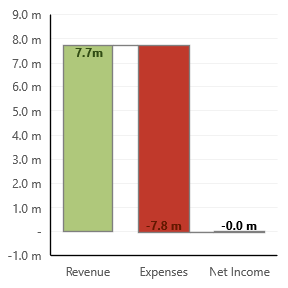
Net Income and Gross Margin
NET INCOME
GROSS MARGIN
COMMENTS
The forecasted net income is -$32,115 on $7,741,639 in revenue. This yields -0.41% in gross margin.
Adding back non-cash expenses yields a 4.7% operating margin ($362k in operating income)
Revenue | 7,741,639
Expenses | 7,773,753
Net Income | -32,115
Revenue | 7,741,639
Expenses | 7,773,753
Net Income | -32,115
Gross Margin | -0.41%
Gross Margin = Net Income / Revenue

Slide 5
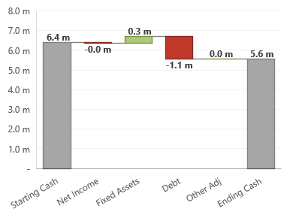
Ending Cash and Days of Cash
ENDING CASH WATERFALL
DAYS OF CASH
COMMENTS
We are predicting 275 days of cash at 6/30/27. This is based upon ending the year with 5,557,172 in cash.
The cash forecast reflects an $832k decrease in FY27, due largely to the planned payment of $1M of current debt before refinancing the balance. Additionally, note that the EOY cash forecast is dependent on the BOY balance, which is derived from our current year forecast and subject to change.
Starting Cash | 6,388,800
Net Income | -32,115
Fixed Assets | 329,111
Debt | (1,141,847)
Other Adj | 13,222
Net Annual Cash Increase | -831,629
Ending Cash | 5,557,172

Slide 6
Days of Cash, In Context
Historical Context: Days of Cash
Industry Context: Days of Cash vs Gross Margin
0%
275
275 DAYS OF CASH AT YEAR'S END
ANNUAL PERFORMANCE VS. CUMULATIVE CASH BALANCE
The budget predicts that we will end the year with 270 days of cash, which is 54 days less than the cash forecast for 6/30/26 – due to the payment of debt principal.
The budget predicts a gross margin of % and an ending cash balance that will provide 275 days of cash. The comparison above is Global’s FY27 budget vs other schools' FY26 forecasted results

Slide 7
SY27 & SY28 Budget
REVENUE
We have budgeted $7,741,639 in revenue based upon 230 students, a PPF foundation payment of $15,454, and a facility payment of $3,850. The largest components of revenue are $7m (90.4%) in State and Local Revenue and $582k (7.5%) in Federal Revenue.
EXPENSES
We have budgeted $7,773,753 in expenses based on 40.6 staff, a 5.7 student to teacher ratio, and 31,928 in square feet for the facility. The largest components of expense are $3,671,882 (47.2%) in Salaries and $965,639 (12.4%) in Direct Student Expense.
Interest expense increases from 173k in FY26 to 199k in FY27 due to the modeled 4.5% interest rate, which is slightly higher than our current rate (4.04% for City First and 1% for OSSE).
ADJUSTMENTS TO CASH FLOW
We have budgeted a $831,629 loss in cash for the upcoming year. The largest adjustments are $395,742 in Add Depreciation and -$1,141,847 in Financing Activities – with the latter our assumptions for a $1M pay down of principal, refinance costs, and new loan principal.

Slide 8
Impact of Refinance Scenarios
Base Assumptions for a Refinance in FY27:
We currently have two loans with the following balances and maturities:
While we do not know what terms we will receive for a refinance, we know that when these loans originated in FY22, rates were historically low due to the pandemic. As we are in a higher-rate environment, we may not experience as favorable terms.
The base assumptions in our current model reflect the following terms:
  30-year amortization
  $4.46M starting principal
  4.5% interest rate
The charts to the right show how two of our key metrics (Days Cash on Hand and Gross Margin) change with different interest rates and repayment assumptions. Depending on the rate ultimately received in a refinance, we can adjust the amount refinanced to match our budgeted income, if desired.
Loan | Rate | Maturity Date | Balance at Maturity
City First | 4.04% | November 2026 | $3,660,971
OSSE | 1.00% | February 2027 | $1,803,640

Slide 9
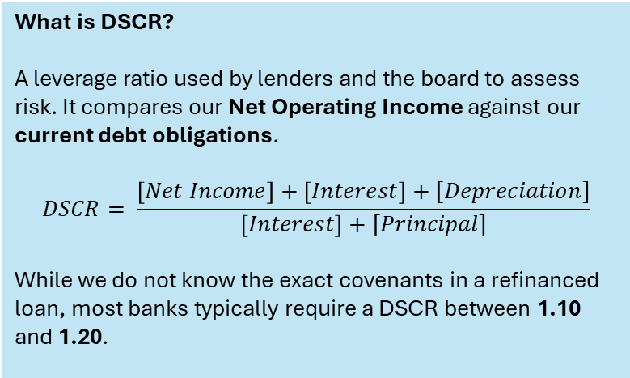
Debt Service Coverage Ratio (Assumed)
What is DSCR?
A leverage ratio used by lenders and the board to assess risk. It compares our Net Operating Income against our current debt obligations.
$$DSCR= \frac{\left[Net Income\right]+\left[Interest\right]+[Depreciation]}{\left[Interest\right]+[Principal]}$$
While we do not know the exact covenants in a refinanced loan, most banks typically require a DSCR between 1.10 and 1.20.

Slide 10
Revenue | Overview
SY27 BUDGETED REVENUE %
REVENUE PER STUDENT
COMMENTS
We have budgeted $7,741,639 in revenue for SY26-27, which is $127k less than the amount forecasted for the year before.
The largest components of revenue are State and Local Revenue (90.4%) and Federal Revenue (7.5%).
Highlighted year-to-year changes:
$111k decrease (3.3% less per student) in State and Local Revenue

Slide 11
Revenue | Sector Comparison
Revenue |  |  |  |  |  |  | SY26-27 | $ Over Median
State and Local Revenue |  |  |  |  |  |  | 7M | $200k
Federal Revenue |  |  |  |  |  |  | 582k | $100k
Private Grants and Donations |  |  |  |  |  |  | 138k | $0k
Earned Fees |  |  |  |  |  |  | 27k | -$200k
Donated Revenue |  |  |  |  |  |  | 0k | $0k
Legend
Washington Global
DC Charters, if they had your population
DC Charters Median

Slide 12
Expenses | Overview
SY27 BUDGETED EXPENSE %
EXPENSE PER STUDENT
COMMENTS
We have budgeted $7,773,754 in expenses for SY26-27, which is $193k more than the amount forecasted for the year before.
The largest components of expenses are Salaries (47.2%) and Direct Student Expense (12.4%).
Highlighted year-to-year changes:
$165k increase (2.9% more per student) in Salaries

Slide 13
Expenses | Sector Comparison
Expenses |  |  |  |  |  |  | SY26-27 | $ Over Median
Salaries |  |  |  |  |  |  | 3.7M | $0k
Benefits and Taxes |  |  |  |  |  |  | 631k | -$300k
Contracted Staff |  |  |  |  |  |  | 0k | -$100k
Staff-Related Costs |  |  |  |  |  |  | 72k | $0k
Rent |  |  |  |  |  |  | 511k | $100k
Occupancy Service |  |  |  |  |  |  | 553k | $200k
Legend
Washington Global
DC Charters, if they had your population
DC Charters Median

Slide 14
Expenses | Sector Comparison (cont.)
Expenses |  |  |  |  |  |  | SY26-27 | $ Over Median
Direct Student Expense |  |  |  |  |  |  | 966k | $200k
Office & Business Expense |  |  |  |  |  |  | 679k | $0k
Donated Expense |  |  |  |  |  |  | 0k | $0k
Contingency |  |  |  |  |  |  | 77k | $0k
Depreciation and Amortization |  |  |  |  |  |  | 396k | $0k
Interest |  |  |  |  |  |  | 217k | $0k
Legend
Washington Global
DC Charters, if they had your population
DC Charters Median

Slide 15

QUESTIONS?
Please contact your
EdOps Finance Manager:
Ross Knorr
ross@ed-ops.com
773-835-2790

Slide 16
Appendix | Profit and Loss Changes
Income Statement |  | SY25-26 | SY26-27 | Difference |  | Comments
Revenue
 | State and Local Revenue | 7,105,598 | 6,994,831 | (110,766) |  | 2.55% PPF rate increase; no facilities rate increase.
 | Federal Revenue | 585,580 | 581,879 | (3,701)
 | Private Grants and Donations | 151,211 | 137,538 | (13,673)
 | Earned Fees | 26,222 | 27,390 | 1,168
 | Donated Revenue | - | - | -
Total Revenue |  | 7,868,611 | 7,741,639 | (126,972)
Operating Expense
 | Salaries | 3,507,382 | 3,671,882 | (164,500) |  | 3% EOY increase for non-instructional staff; increased instructional scale
 | Benefits and Taxes | 607,279 | 631,345 | (24,066)
 | Contracted Staff | 14,125 | - | 14,125
 | Staff-Related Costs | 83,380 | 71,738 | 11,641
 | Rent | 501,482 | 511,482 | (10,000) |  | No growth in facilities rate means no rent increase; higher property insurance assumed.
 | Occupancy Service | 550,861 | 552,875 | (2,014)
 | Direct Student Expense | 899,626 | 965,639 | (66,013)
 | Office & Business Expense | 738,435 | 678,958 | 59,477
 | Donated Expense | - | - | -
 | Contingency | 79,488 | 77,416 | 2,072 |  | 1% of revenue.
Total Operating Expense |  | 6,982,057 | 7,161,337 | 179,279
Net Operating Income |  | 886,553 | 580,302 | (306,251)
Interest, Depreciation
 | Depreciation and Amortization | 387,406 | 395,742 | (8,337)
 | Interest | 210,845 | 268,759 | (57,914) |  | Higher interest rate on $1M less principal balance.
Total Expenses |  | 7,580,308 | 7,825,838 | 245,530
Net Income |  | 288,302 | (84,200) | (372,502)
Adjustments To Cash Flow |  | SY25-26 | SY26-27 | Difference |  | Changes
 | Net Income | 288,302 | (84,200) | (372,502)
 | Add Depreciation | 382,128 | 395,742 | 13,614
 | Operating Fixed Assets | (53,263) | (55,832) | (2,569)
 | Buildings | (51,566) | (10,800) | 40,766
 | Other Operating Activities | 63,110 | 13,222 | (49,888)
 | Financing Activities | (142,437) | (1,141,847) | (999,410) |  | Refinance
 | Per-Pupil Adjustments | (0) | - | 0
 | Suspense | - | - | -
 | Facilities Project Adjustments | - | - | -
Net cash increase for year |  | 486,275 | (883,714) | (1,369,989)

